Slide 1
Beer Maven
A Beer Recommendation App

Slide 2
Problem Statement
Lots of new craft beers with funky names: Curly Wolf, Denogginizer, Luponic Distortion
Bars, Restaurants, Grocery stores offer lots of choices with little to no description
Other beer recommendation apps don’t take availability into account
Beer is Expensive! Picking a beer you do not like sucks!

Slide 3
Basic Function
Allow users to search for beers and add to list
Have users rate 9 major beer groups on a 1-5 scale:
IPA/Pale Ales, Dark Ales, Pale Lagers, Dark Lagers, Wheat Beers, Porter Stouts, High ABV, Fruity/Spiced, and Non-Alcoholic
Predict the score users will give each beer on the list
Return the beer list sorted by predicted rating

Slide 4
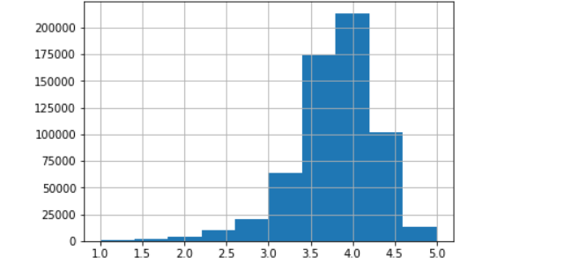
The Data
Over 600,000 beer ratings from the top 250 raters on beeradvocate.com
1-5 scale outlined by beeradvocate founders:
4.50 - 5.00 = World-Class 4.25 - 4.49 = Outstanding 4.00 - 4.24 = Exceptional 3.75 - 3.99 = Very Good 3.50 - 3.74 = Good 3.00 - 3.49 = Okay 2.00 - 2.99 = Poor 1.00 - 1.99 = Awful
Ratings are bunched up heavily between 2.5 and 4.5

Slide 5
Recommendation System
Built using python Surprise module
Uses a KNN algorithm with baseline
Predicts the users rating of a beer
.3532 Root Mean Squared Error and .2476 Mean Absolute Error

Slide 6
Whoosh
Provides search functionality for fast adding to beer list
Trained on the set of all beer and brewery names
Multifield Search Query allows users to search for beer, brewery, or both
Works best with full beer names
Ex: Fat Tire Amber Ale instead of just Fat Tire

Slide 7
Cold Start Problem
Recommendation system knows nothing about new users
System is not sensitive enough even after 10-20 ratings
Recommends beers according to their average rating from the dataset
Scrape beer style data from beeradvocate for all beers in the dataset
Group beer styles into 9 supergroups
Have users rate beer styles on a 1-5 scale
Modify ratings in the dataset according to the rating for the group each beer falls into

Slide 8
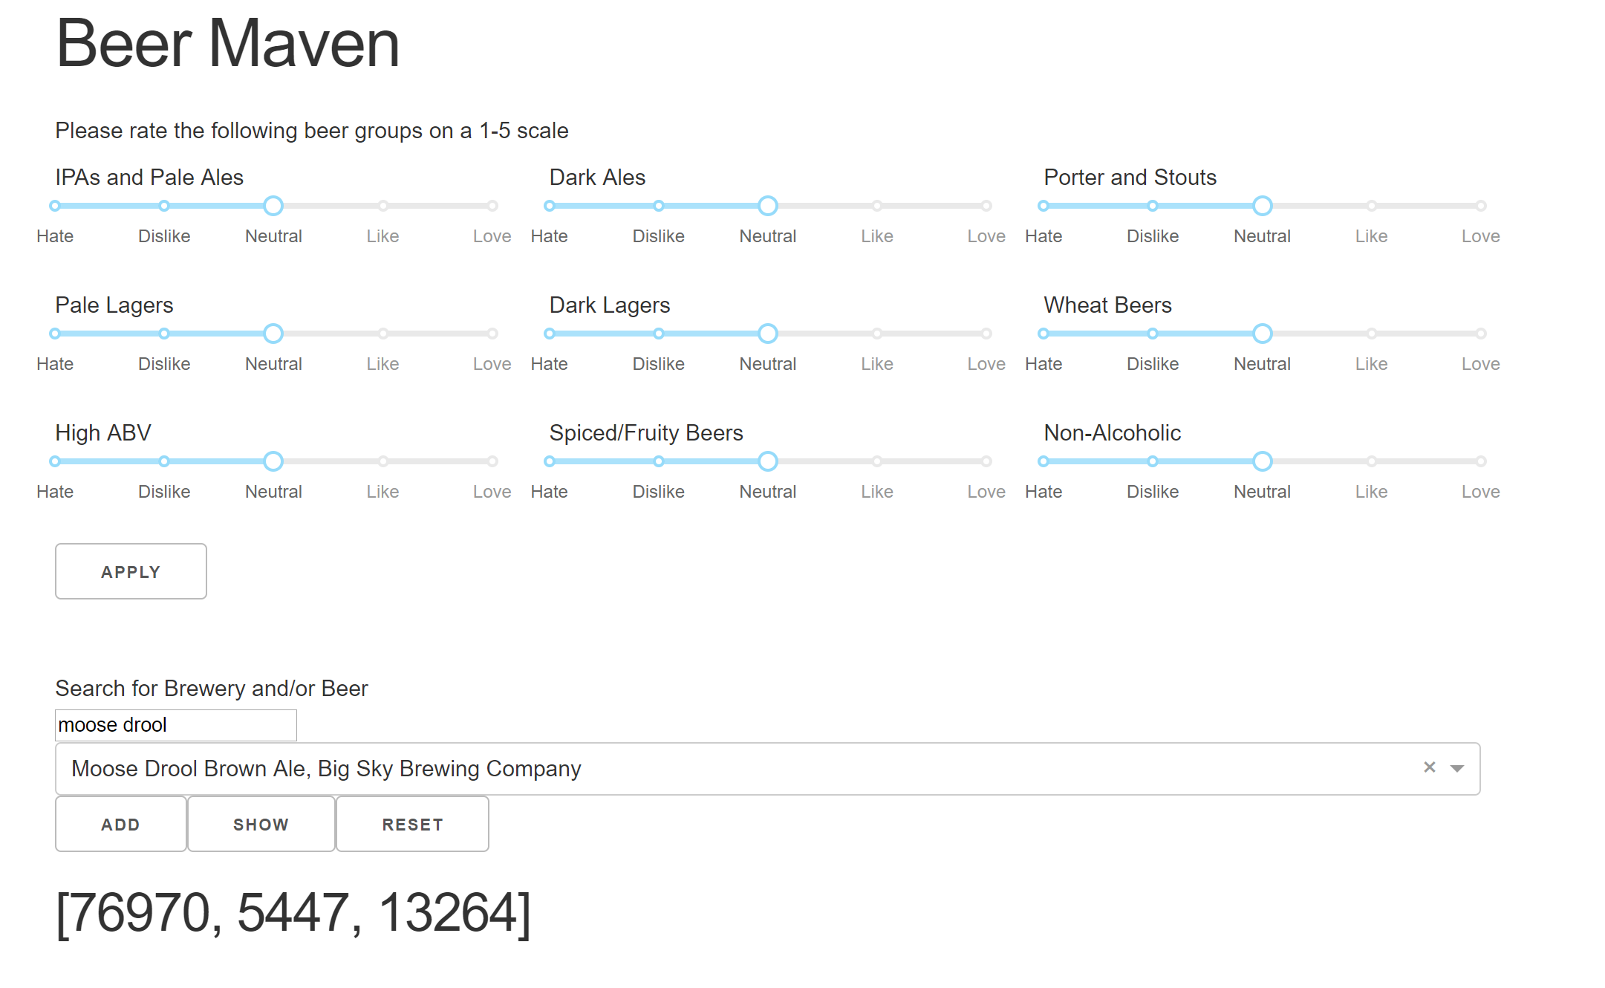
The App
Built using Plotly Dash
Brings the different elements together in one place
Searching for beers, adding to list, predicting scores, sorting beer list
Runs slowly for the time being, needs to be optimized
Hit “add” button twice when adding first beer to list

Slide 9
Future Improvements
Optimize the app so it runs faster
Improve search functionality so its less picky about full names
Add Optical Character Recognition feature to allow users to scan beer lists in lieu of manually building them
Improve app interface to make it less clunky
Add key phrases from text reviews for top beers to search result

